Slide 2





Empowering postdocs adaptable research careers with Prosper
Dr Fiona McBride, Senior Researcher Developer
Led by
Supported by
An Academy project

Slide 3
Overview
What Prosper is and what it offers
Where Prosper is now and where we are going
Our impact (so far)
How institutions are implementing Prosper

Slide 4
What is Prosper?
Prosper is an innovative approach to postdoc career development that seeks to unlock postdocs’ potential to thrive across multiple career pathways - both within and beyond academia.
The Prosper Portal is a free-to-use online hub containing a wealth of information, tools and resources for postdocs, managers of researchers, and institutions – including all of the materials from the pilots, and far more.

Slide 5
How did we do it? Co-creation

Slide 6



The Career Development Navigator
1
What job would suit me?
Thrive wherever you are
9
Tailor your career exploration and expand your network
Develop the right skills
6
Is now the right time to make a change?
2
8
Prepare for the next step
5
7
Find the right direction for you
3
4
Options and challenges
Discover what’s out there

Slide 7
Prosper for Managers of Researchers
Support team members' career development
Develop leadership and management skills
Foster a positive, inclusive working environment
Connect and share best practice with other managers across the UK via the Prosper PI Network – a unique, free, cross-institutional forum for PIs to connect with peers and develop people management skills
“Prosper gave my postdoc an open mindedness about the options in terms of a further career and has made working together a really positive experience”
Professor of Health Science, University of Liverpool

Slide 8
Prosper for Institutions
A flexible and free career development model, co-created and developed on a cross-institutional basis
Enhance existing postdoc career development offerings, run a full Prosper cohort, or simply signpost the Prosper Portal
Join the Community of Practice and collaborate to improve research culture
“Prosper was so useful. We were able to put together an engaging and well-structured series that research staff and PGRs really benefited from, with minimal time and cost, thanks to all the ready-made materials already available.”
Dr Gabriele Matilionyte, Researcher Development Consultant, Heriot-Watt University

Slide 9
Where Prosper is now - Rollout

Slide 10











The Prosper Roadmap
Nov 2019 - August 2023
Prosper model co-created with stakeholder groups; postdocs, PIs and employer partners. Tested and revised with two cohorts, working across Lancaster University, the University of Liverpool, and Manchester.
October 2023
PI Network – a forum for PIs to share practice and develop leadership skills – is launched to sector
February 2025
The first Prosper Practice Exchange event, hosted in Manchester
August 2026
End of UKRI funding (but not the end of Prosper!)
October 2019
Prosper begins as Research England Development (RED) fund project
August - September 2023
RED funding ends, Prosper becomes UKRI-funded. Prosper launches to sector in September and begins rollout.
January 2025
Prosper cohorts delivered at nine Higher Education Institutions across the UK
February 2026
Prosper reciprocation framework to be launched following pilot phase with early adopters

Slide 11
What we achieved – since September 2023 to now
Approaching 1,500 registrations to Portal
Approaching 70 institutions using Prosper
Five institutional case studies published/collected so far
Six thought leadership pieces published
Employer insight session with Environment Agency – 120+ registrations
PI network - Sessions have attracted 323 registrations from 50+ institutions, in the UK and beyond
Notes:
Cohort model will be adopted by nine institutions from 2025
Employer Insight Session - Inizio Medical 14/May/2025
Insight session - Exploring Careers at the Intersection of Academia and Industry -12 June 2025
Employer Insight session with Dr Maddy Hallewell, Driver and Vehicle Standards Agency – held on 27/2/25 led by Uni of Nottingham
Career Exploration interview: Patently Novel Careers - Science, Law and Licensing. A chat with Dr Anthony Kavanagh – held 23/1/25
Demystifying the recruitment process – your questions, answered –held on 3/12/24

Slide 12
Impact

Slide 13
The Impact of Prosper on postdocs
Confidence
"I felt very supported by Prosper – it was like I was building myself up again from scratch. It gave me back the confidence I’d lost. I was able to find more time to do the things that I enjoy and in doing so felt happier and more motivated to tackle career issues."
Dr Zohra Butt, Prosper postdoc

Slide 14
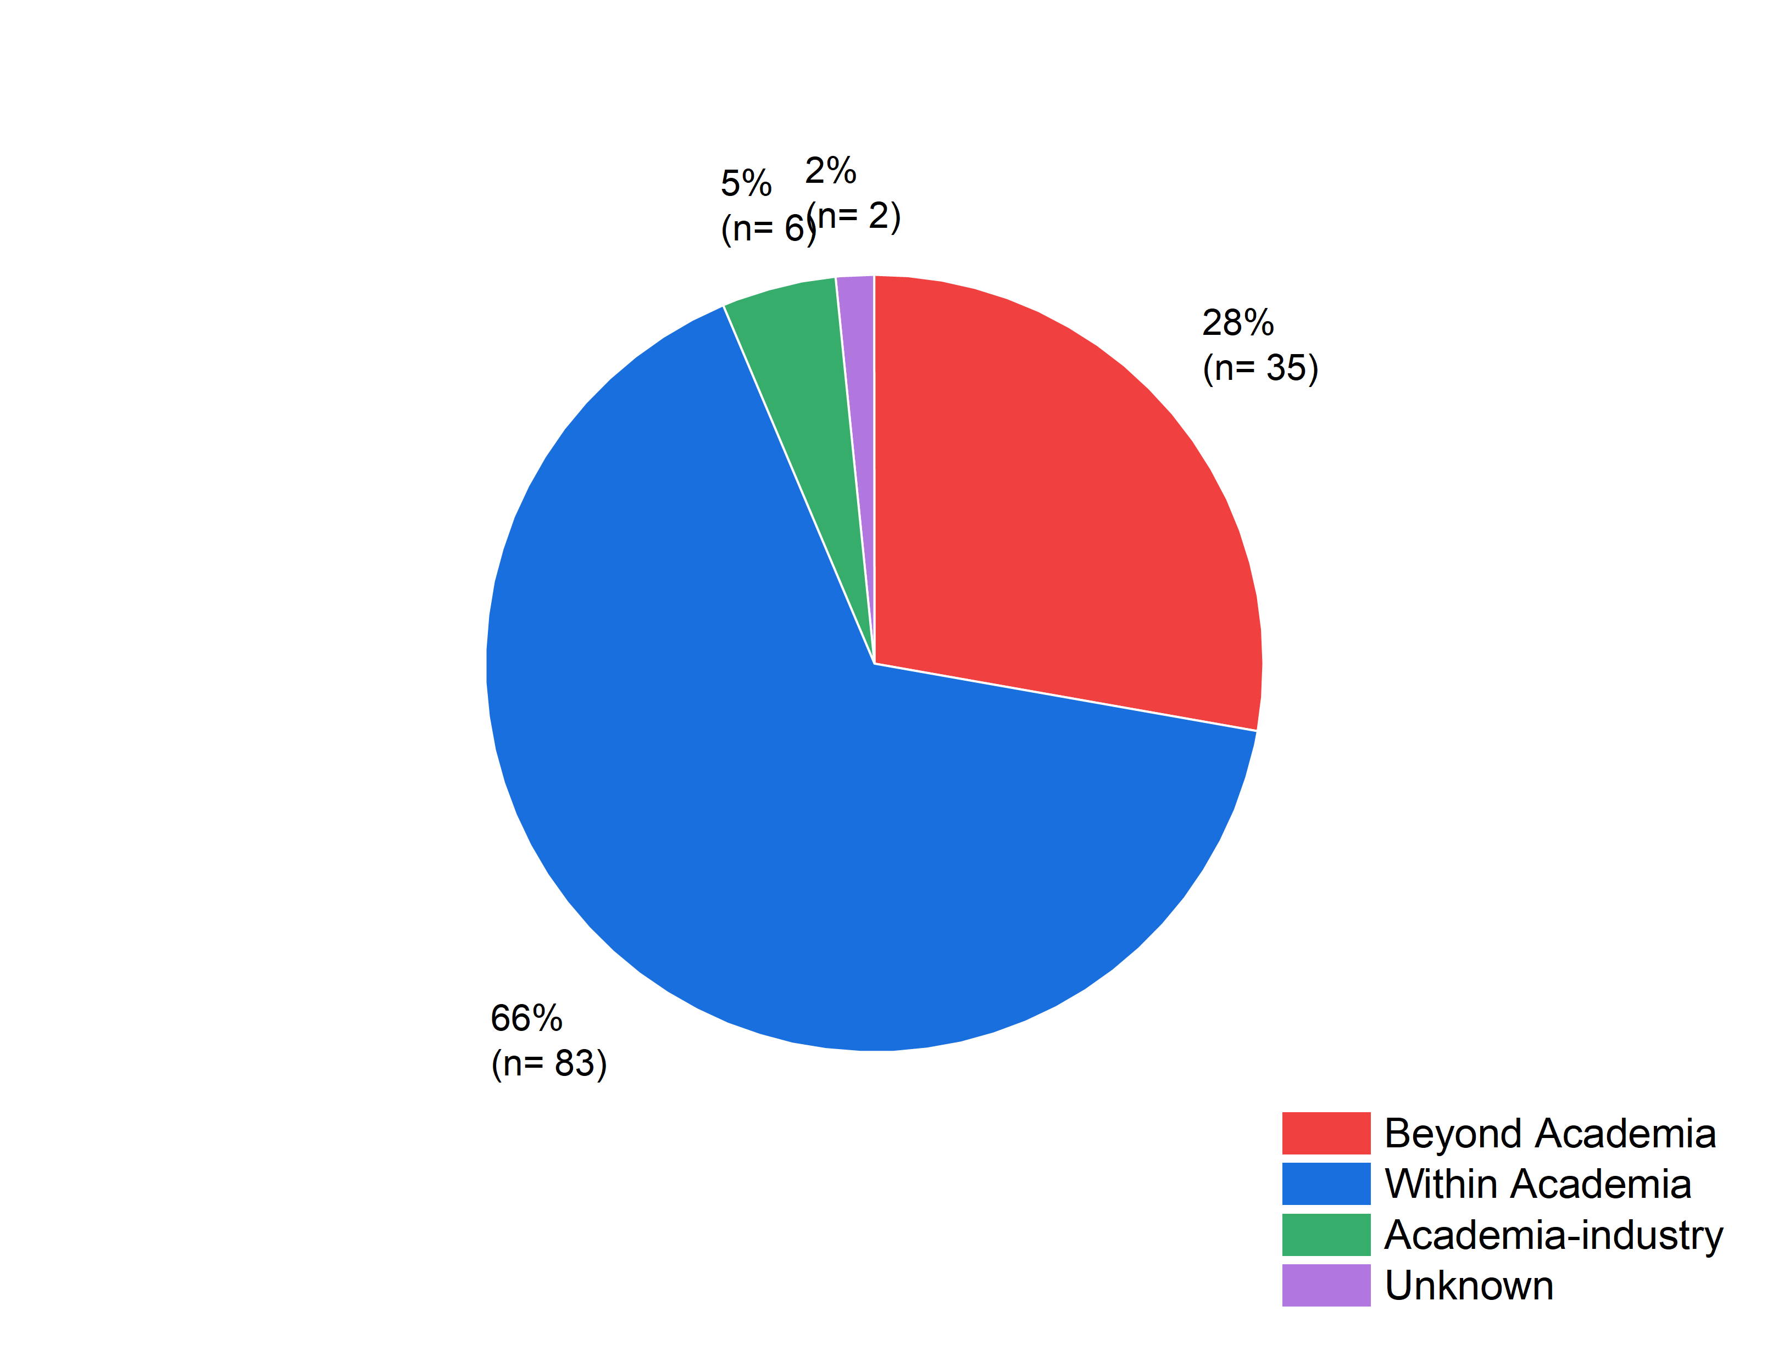
The Impact of Prosper on postdocs - longitudinal
Pie-chart of the combined current (February 2024) data of the job roles of both pilot cohorts.
https://www.researchprofessionalnews.com/rr-news-uk-views-of-the-uk-2025-march-increasing-mobility-of-research-careers-demands-a-better-map/
and
https://prosper.liverpool.ac.uk/keeping-track/

Slide 15
The Impact of Prosper on postdocs - qualitative
Is there anything you picked up during the Prosper cohort that you’re still applying?
Yes – particularly around themes of taking ownership of training and career direction. I continue to treat technical, communication, and interpersonal skills as equally important in my science and software-focused role; something I often forgot before engaging with Prosper.
Dr David Ashmore
Is there anything you picked up from your time with Prosper that you are still actively using in terms of your development?
Lots!
I think the main one that’s applicable to me right now is the reflection element – thinking about things holistically and in terms of my sense of purpose. How to do different things affect me emotionally, what gives me motivation, etc. – because ultimately this is the driver of not only performance, but also wellbeing.
The ‘sunk cost fallacy’ is also always in my head now!
Dr Devon Crouch
https://prosper.liverpool.ac.uk/postdoc-resources/explore/former-prosper-pilot-postdocs-case-studies/dr-david-ashmore/
https://prosper.liverpool.ac.uk/postdoc-resources/explore/former-prosper-pilot-postdocs-case-studies/dr-devon-crouch/

Slide 16
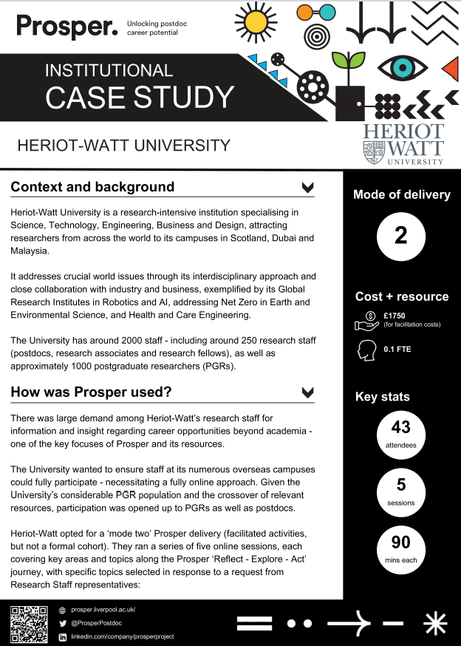
Institutional case studies
Showcasing the use of Prosper to institutions through real-life case study examples.
Brings the flexibility of Prosper to life.
Read the case studies in full
Heriot-Watt https://prosper.liverpool.ac.uk/institutional-case-study-heriot-watt/
Newcastle University https://prosper.liverpool.ac.uk/institutional-case-study-newcastle-university/
University of Liverpool https://prosper.liverpool.ac.uk/institutional-case-study-the-university-of-liverpool/
University of Manchester https://prosper.liverpool.ac.uk/institutional-case-study-university-of-manchester/

Slide 17
Ensuring sustainable impact through
Prosper Exchange

Slide 18
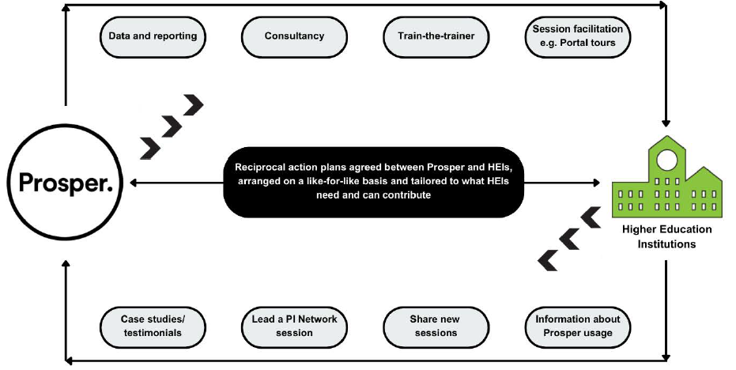
How does Prosper Exchange work?

Slide 19
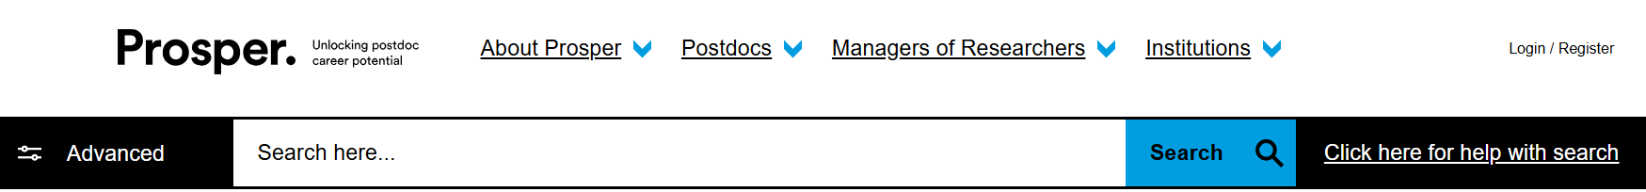
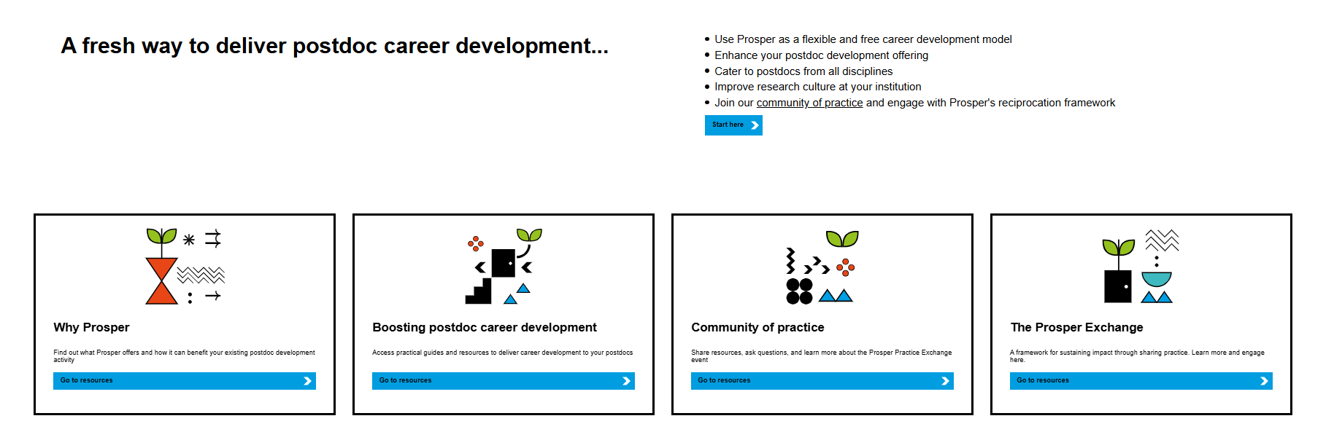
Where to find more details on the Portal:
Click on ‘Institutions’

Slide 20

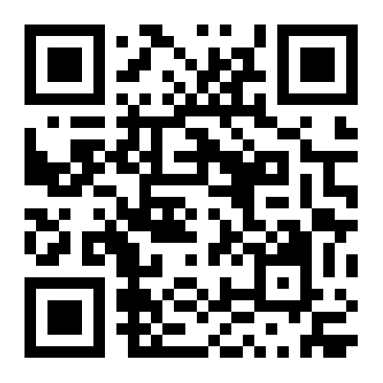
Prosper Exchange - sustaining impact through sharing practice
26 June 2025, Online (Zoom)
Join the Prosper team for an online event to officially launch the pilot of the Prosper Exchange – a framework designed to sustain the future impact of Prosper, keeping resources relevant and free to access for all users.
The event will serve as a follow-up to the Practice Exchange in February, providing an opportunity to connect with peers to discuss Prosper use and share postdoctoral career development practice.
https://www.eventbrite.co.uk/e/prosper-exchange-sustaining-impact-through-sharing-practice-tickets-1323533808249?aff=oddtdtcreator

Slide 21

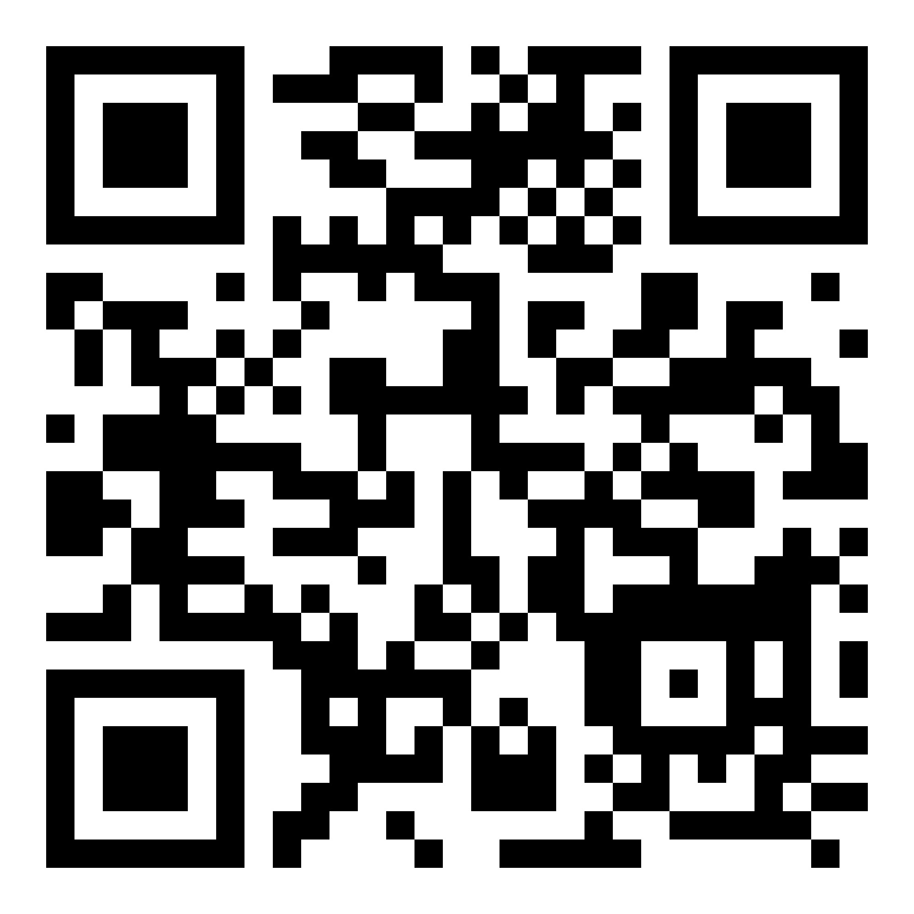
Thank you. Get in touch:
Email prosper.postdoc@liverpool.ac.uk
Website https://prosper.liverpool.ac.uk/ and https://www.liverpool.ac.uk/researcher/prosper/
LinkedIn https://www.linkedin.com/company/prosperproject/
Bluesky @prosperpostdoc.bsky.social
Led by
Supported by
An Academy project

